Slide 1

UNIVERSITY OF BAHRAIN
College of Science
Department of Postgraduate Programs
Deep Learning Mechanisms for Automated Customer Care Interviews Using Video Monitoring System Data
A Master Project Submitted in Partial Fulfilment of the Requirements for the M.Sc. Degree in Big Data Science and Analytics
Prepared by:
Sadiq Jaffer Saleh Isa
Student ID: 20021278
Supervised by
Dr. Hesham Al-Ammal
University of Bahrain
Kingdom of Bahrain
February 2021

Slide 2
Presentation Outline
Research Problem
Object
Procedures and Methods
Results
Recommendations
Introduction
Data
Notes:
This the presentation outline . however, there will be subpoints in Procedures and methods and the Results .

Slide 3
Introduction
The quality assurance team always aims to monitor and observe the processes and the procedures to maintain high quality standards for customer services. However, the whole process seems to be challenging as the team needs to verify multiple scenarios from the video monitoring system (VMS) manually by watching recorded customer interviews with the front-line staff.
Verifying multiple scenarios manually from the video monitoring system (VMS) by watching recorded customer interviews with the front-line staff.
Notes:
In any Organizations that care and focused on the customers ,They having a way to measure quality of sales and service Example : The Mystery shopping , the Video Monitoring system VMS.
The quality assurance team always aims to monitor and observe the processes and the procedures to maintain high quality standards for customer services. However, the whole process seems to be challenging as the team needs to verify multiple scenarios from the (VMS) manually by watching recorded customer interviews with the front-line staff.

Slide 4
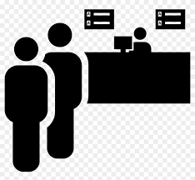


Research Problem
Maintaining a proper evaluation on monthly basis using traditional methods with large number of interviews is hard because it is time consuming and needs a lot of manpower efforts.
Notes:
Maintaining a proper evaluation on monthly basis using traditional methods with large number of interviews is hard because it is time consuming and needs a lot of manpower efforts.
the aim of this thesis is to create a mechanism based on deep learning to automate the evaluation of the interview videos.

Slide 5
Objectives
To identify the elements of the customer service front-line staff’s quality assurance process that can be automated within the scope of the project and based on the available data.
To use a deep neural network to extract the front-liner staff’s face landmark features and emotions, which then can be used to assess the identified elements for automation purposes.
To examine the big data analytics approach in dealing with labeled and unlabeled evaluations.
To study the relationship between the extracted features and the evaluated results.
Notes:
To identify the elements of the customer service front-line staff’s quality assurance process that can be automated within the scope of the project and based on the available data.
To use a deep neural network to extract the front-liner staff’s face landmark features and emotions, which then can be used to assess the identified elements for automation purposes.
To examine the big data analytics approach in dealing with labeled and unlabeled evaluations.
To study the relationship between the extracted features and the evaluated results.

Slide 6
Data
This project utilizes a dataset related to the Bahrain Telecommunications Company, Batelco(14 branches).
The available videos that were provided by the company are around 6o TB but only 60 interviews were evaluated.
The dataset includes an excel sheet which has videos’ details about front-line staff and the evaluation captured by the quality team. The dates of the videos in this dataset are from June 2019 until March 2020.
An audio survey was conducted. The main purpose of the survey was to collect speaker’s voices for important twelve phrases or words to be used in training a classification model.
Notes:
This project utilizes a dataset related to the Bahrain Telecommunications Company, Batelco(14 branches).
The available videos that were provided by the company are around 6o TB but only 60 interviews were evaluated.
The dataset includes an excel sheet which has videos’ details about front-line staff and the evaluation captured by the quality team. The dates of the videos in this dataset are from June 2019 until March 2020.
An audio survey was conducted. The main purpose of the survey was to collect speaker’s voices for important twelve phrases or words to be used in training a classification model.

Slide 7
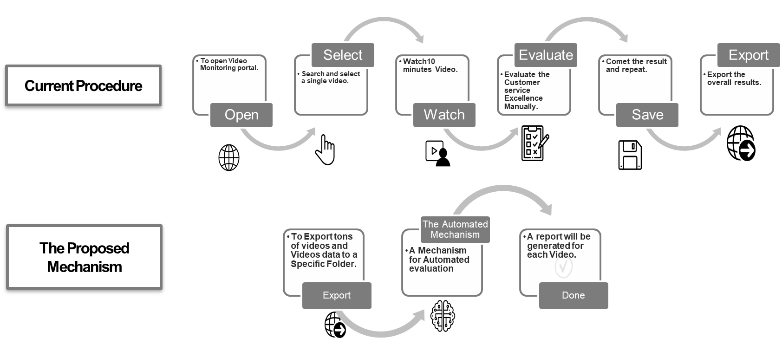
Current Procedure VS Proposed Mechanisms
Procedures and Methods
Notes:
In the existing procedure, the Training Department staff followed several steps to complete a single evaluation for a single interview.
First step is to open the VMS portal, noting that the VMS portal is the user interface which is the gate to all the interviews recorded for all front-line staff. Then search for a random interview for a specific month for staff “A”. After that, evaluating the staff based on predefined customer service criteria, followed by saving the results and repeating the whole process for staff “A” with different interviews a couple of times depending on the daily target to conduct evaluations. Finally, moving to staff “B” and repeating the same scenario.

Slide 8

Procedures and Methods
What elements can be automated in the evaluation?

Slide 9
Procedures and Methods
Audio
Closing statement
Welcoming
Courtesy words
“Anything Else”
Evaluation Elements
Frames
Overall Appearance
Smile
Eye Contact
Cross-sell / Up-sell
Notes:
the evaluation elements have been divided into two types; a type that can be classified from the frames and a type that can be classified from the audio.
A type that can be classified from the frames.
Evaluating whether the front-line staff was smiling or not.
Evaluating whether the front-line staff had proper eye-contact during the conversation.
A type that can be classified from the audio.
Evaluating whether the front-line staff welcomed the customer or not.
Evaluating whether the front-line staff said courtesy words or not.
Evaluating whether the front-line staff said, “Anything Else?” or not.
Evaluating whether the front-line staff said a closing statement.
The front-line staff’s overall appearance was excluded because all the evaluation results were positive and there were no negative examples.
Also the cross-sell or up-sell was excluded as there is no standard sentence or a phrase to capture and classify this. The only way to include this part is Arabic sentiment analysis which is out of this project’s scope.

Slide 10


Stage 1 Converting Interviews to Frames
Procedures and Methods - Frames
Using OpenCV library
Full interview
Extract a single frame from each second, specifically last frame.
Target Folder
Interview_1
Interview_2
Frames
Interview 1_Frame_1
Interview 1_Frame_2
Interview 1_Frame_n
Interview 2_Frame_1
Interview 2_Frame_2
Interview 2_Frame_n
Frames
Frames Extraction Flow chart
Notes:
-The first step is to Split the audio / video then to convert the video to frames . Will take one frame from each second .
-Automatically Folders and sub folders will be created as illustrated while maintaining their unique naming to retrieve them in next stages.

Slide 11
Baseline Training Dataset
Procedures and Methods- Frames
6 Interviews
3 males
3 females
Dataset Selection Criteria:
Different branches
Different front-line staff
Pre-evaluated interviews by the quality assurance team
Duration for each interview was 10 minutes.
Challenging situation occurred at this stage
We are dealing with frames not whole videos and the available evaluation if for full videos.
Overcoming the challenge
Evaluating the frames manually by recognizing eye contact & smile.
Notes:
6 Interviews as A Baseline Training Dataset six interviews were selected with three males and three females from different branches and different front-line staff

Slide 12
Observations during manual evaluation
Procedures and Methods - Frames
All the desks and the monitors have a standard position in all branches.
The front-line staff can be working in different branches maybe as overtime or they can be reallocated and not specifically that any staff will be fixed at a particular branch.
The PCs can be used by different front-line staff.
Most of the frame captured were of faces from the side and not in straight position. This meant that there will be an ability to see only one side of the front-line staff’s face.
The label distribution for both eye contact & smile was imbalanced, as the frames with no eye contact is much higher than the frames with eye contact.
And the last observation is, there was no guarantee that one staff appears at the same frame and it might be more than one staff or even no-one is available “empty frame”.
Notes:
All the above observations supported in designing and building the correct systems and reaching high accuracy with minimal errors.

Slide 13
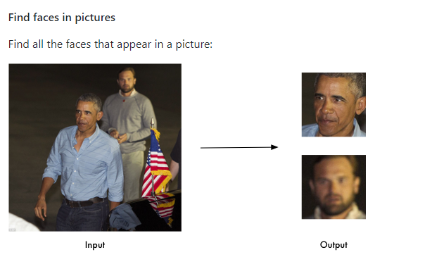
Stage 2 Face Detection and Face Recognition
Procedures and Methods- Frames
face_recognition Library
Important Points:
The frame might contain no faces. In this case the frame will be deleted, and it does not need any further work.
The frame might contain a face other the actual owner of the system. The process here will be the same as the previous point and the frame will be deleted.
The frame might contain more than one face. In this case a loop will go through each face within the frame to identify whether it is the relevant face or not, then crop and save the relevant face to the face’s directory.
The frame contains only one face. Then the system will detect the face using the process explained above and crop the picture based on the four coordinates of the face.
224X224 Pixels
(Geitgey, 2020)
Notes:
A comprehensive solution related to face detection and face recognition had been used at this stage, which is a library called face_recognition.

Slide 14
Procedures and Methods- Frames
Target Folder
Interview_1
Frames
Interview 2_Frame_Faces_1
Interview 2_Frame_Faces_2
Interview 2_Frame_Faces_3
Interview 2_Frame_Faces_n
Frames
Interview_2
Faces
Interview 1_Frame_Faces_1
Interview1_Frames_Faces_2
Faces
Interview1_Frames_Faces_3
Interview1_Frames_Faces_n
Notes:
Faces folder will be created which contains the true positives to be more specific (the images that are related to the actual front-line staff that need to be captured and evaluated in the interview excluding anyone else such as the shop manager, empty frames etc).

Slide 15


Euclidean Distance (Face Recognition)
Procedures and Methods- Frames
Targeted frame to be recognized
known faces directory
Challenge:
Euclidean distance can be used with limited number of classes “front-line staff pictures” and after moving to larger number of classes, the accuracy level of this method is getting lower.
While tracing the false negative via the visual studio code debugger, that the second option in the results or in some cases the third option is the correct front-line staff.
Staff X
Staff 1
Staff 2
Generating 128 measurements
Generating 128 measurements
Generating 128 measurements
Higher distance = not matching face “ignored”
Compare results by calculating the Euclidean distance
Lower distance = matching face
Notes:
tolerance is 0.6

Slide 16

K-Nearest Neighbors (KNN) (Face Recognition)
Procedures and Methods- Frames
Classifying the faces according to the highest votes using the 128 measurements.
Different Ks were tested
K3
K5
K7
K9
Tracing the highest number of true positives and the lowest number of false positives.
Correct face captured
Saved in the faces’ directory

Slide 17
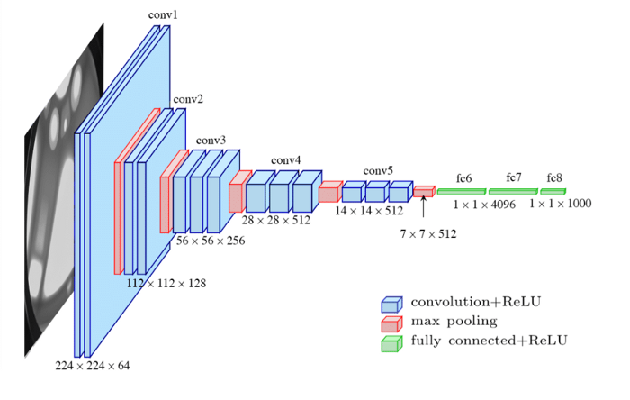
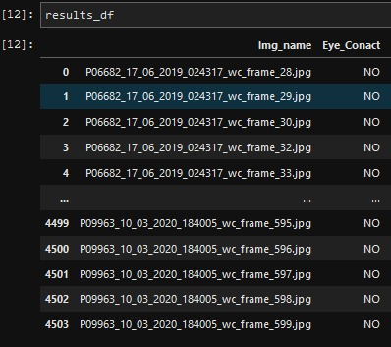
Attempt 2: Transfer Learning
Procedures and Methods- Frames
Stage 3 Eye Contact
4192 Evaluated Frames
2682 Training dataset
671 Validation Dataset
839 Test Dataset
Using
VGG16
VGG16 Layers (Khandelwal, 2020)
+ 2 Additional Layers
+ 50% dropout in between
+ Changing the output layer to SoftMax
Pandas’ Data Frame
Notes:
We used a pre-trained model by (Khanzada et al., 2020), that used VGG16 for facial emotion recognition, which we can use in transfer the learned features to train the dataset. Also, Khanzada used his model in emotions with human faces so its is familiar with faces and his model was available in Github.
the total evaluated frames were 4192 for 29 interviews

Slide 18

Stage 4 Smile Detection
Procedures and Methods - Frames
Pre-trained model by Amil Khanzada using VGG16.
Model was trained using FER2013 dataset.
Multiple classes of the emotions were ignored and only the happy class was considered in testing.
Notes:
Similarly, to what had been applied in eye contact, to detect the smile VGG16 model was used as it is without applying any changes. The model achieved good results with Khanzada.He applied the model on FER2013 dataset which was tough dataset. The dataset that is used in this project is much simpler than the FER2013, that is why it is expected to get better outcomes during this experiment.

Slide 19
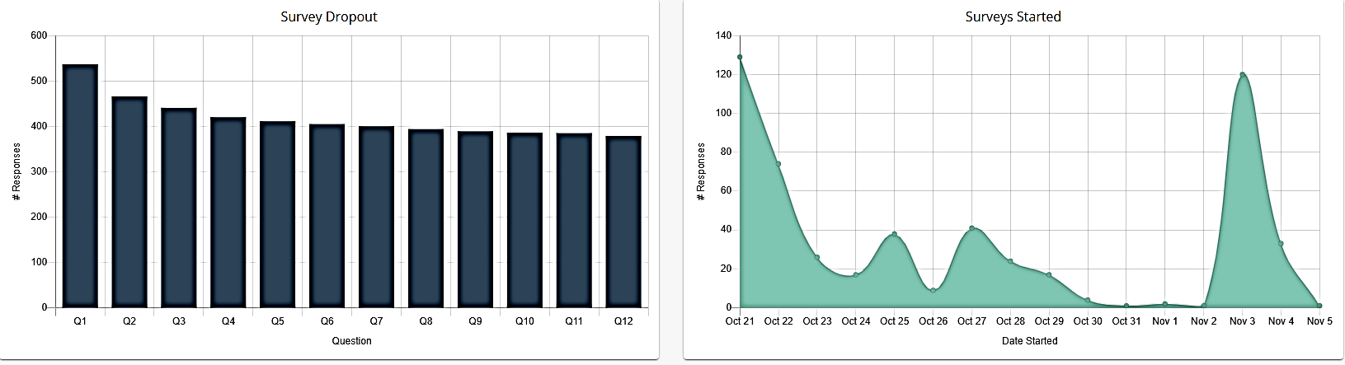
Procedures and Methods - Audio
Speech Survey
The audio phrases survey had 539 participants,. Most of them recorded 12 phrases or words in Arabic language with their native accent.
Survey Progress from Launching day to the last day, captured from the survey website

Slide 20
Procedures and Methods - Audio
Speech Survey
Serial | Type/Category | synonyms in English | Phonetics/Subcategory | Phrases or words in Arabic
1 | Welcoming and Greeting | Islamic greeting | Wa Alikom Al-Salam | وعليكم السلام
2 | Welcoming and Greeting | please enter | Tafadhal | تفضل
3 | Welcoming and Greeting | Have a seat | Hayyak | حياك
4 | Courtesy Words | Hello Sir | Hala Alshaikh | هلا الشيخ
5 | Welcoming and Greeting | Hello | Marhaba | مرحبا
6 | Closure | Goodbye | Ma’a Alsalama | مع السلامة
7 | Closure | God bless you | Hayak ALLAH | حياك الله
8 | Closure | God grant you peace | ALLAH Yesalmak | الله يسلمك
9 | Courtesy Words | You are Welcome | Hadhreen | حاضرين
10 | Anything else | - | Ay Khedma Thaniya | أي خدمة ثانية؟
11 | Anything else | - | Ta’amer Ala She Thani | تأمر على شي ثاني؟
12 | Closure | God grant you peace | Fi Aman ALLAH | في أمان الله
# | Quantity | Train | Test
1 | 364 | 255 | 109
2 | 333 | 233 | 100
3 | 342 | 239 | 103
4 | 316 | 221 | 95
5 | 177 | 124 | 53
6 | 317 | 222 | 95
7 | 243 | 170 | 73
8 | 315 | 220 | 95
9 | 299 | 209 | 90
10 | 316 | 221 | 95
11 | 299 | 209 | 90
12 | 305 | 213 | 92
Phrases or words that had been used in the survey
Audio Test and Train Distribution

Slide 21
Procedures and Methods - Audio
Audio Model Architecture
Starting from a Kapre layer that computes Mel-Spectrograms directly from the wave file as input with shape (160000,1) followed by normalization layer which is already integrated with Kapre library. Followed by the classic convolutional neural network architecture which is 6 pairs of two dimensions convolutional layer and Max Pooling layer, then flatten, Dropout, Dense and ending with Sofmax activation as there are 13 subcategories. The architecture is similar to (de Andrade et al., 2018) and (Seth, 2020) with major amendment.
Layer | Kernel/Pooling Size | Filters | Output | Activation | Parameters
Kapre | N/A | N/A | (None,1000,128,1) | N/A | 0
Normalization | N/A | N/A | (None,1000,128,1) | N/A | 256
Conv2D | 7×7 | 16 | (None,1000,128,16) | tanh | 800
Maxpooling2D | 2×2 | N/A | (None,500,64,16) | N/A | 0
Conv2D | 5×5 | 8 | (None,500,64,8) | Relu | 3208
Maxpooling2D | 2×2 | N/A | (None,250,32,8) | N/A | 0
Conv2D | 3×3 | 8 | (None,250,32,8) | Relu | 584
Maxpooling2D | 2×2 | N/A | (None,125,16,8) | N/A | 0
Conv2D | 4×4 | 8 | (None,125,16,8) | Relu | 1032
Maxpooling2D | 2×2 | N/A | (None,63,8,8) | N/A | 0
Conv2D | 3×3 | 8 | (None,63,8,8) | Relu | 584
Maxpooling2D | 2×2 | N/A | (None,32,4,8) | N/A | 0
Conv2D | 3×3 | 16 | (None,32,4,16) | Relu | 1168
Maxpooling2D | 2×2 | N/A | (None,16,2,16) | N/A | 0
Conv2D | 8×8 | 16 | (None,16,2,16) | Relu | 16400
Maxpooling2D | 2×2 | N/A | (None,8,1,16) | N/A | 0
Batch Normalization | N/A | N/A | (None,8,1,16) | N/A | 64
Flatten | N/A | N/A | (None,128) | N/A | 0
Dropout | N/A | N/A | (None,128) | N/A | 0
Dense | N/A | 32 | (None,32) | N/A | 4128
Dense | N/A | N/A | (None,13) | SoftMax | 429

Slide 22
Procedures and Methods - Audio
Stage 5
Target Folder
Interview_1
Frames
Interview 2_Audio_Chunk_1
Interview 2_Audio_Chunk_2
Interview 2_Audio_Chunk_3
Interview 2_Audio_Chunk_n
Frames
Interview_2
Faces
Interview 1_Audio_Chunk_1
Interview 1_Audio_Chunk_2
Faces
Interview 1_Audio_Chunk_3
Interview 1_Audio_Chunk_n
Audio Tracks
Audio Tracks
Audio Directory

Slide 23
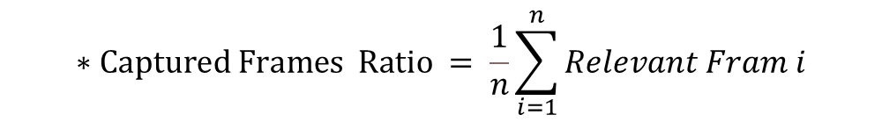
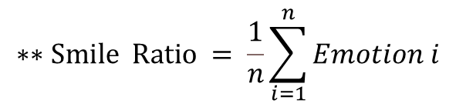

Procedures and Methods - Stage 6
Overall Preprocessing and aggregation
As the frames’ results need to be transformed from single frame evaluation to overall interview video collective evaluation.
$$∗Captured Frames Ratio = \frac{1}{n}\sum_{i=1}^{n}{Relevant Fram i}$$
$$∗∗Eye Contact Ratio = \frac{1}{n}\sum_{i=1}^{n}{Eye Contact i}$$
$$∗∗Smile Ratio = \frac{1}{n}\sum_{i=1}^{n}{Emotion i}$$
Going to the audio part, the audio is straight forward at this stage. Since the processing is on audio chunks, each 10 seconds chunk will be evaluated and saved in a Pandas data frame. Then, the subcategory is mapped to its category for example (Hi, Hello) will be categorized as “welcoming and greeting”.
*Where n is the number of frames
**Where n is the number of 𝑅𝑒𝑙𝑒𝑣𝑎𝑛𝑡 𝐹𝑟𝑎𝑚s
Notes:
As the frames’ results need to be transformed from single frame evaluation to overall interview video collective evaluation. In other word, the ratio will be calculated. Since, the ratio of the evaluation results is taken, the number of the captured frames will be ignored. Therefore, it was decided to calculate the ratio of the captured frames as well.

Slide 24
Procedures and Methods - Stage 6
Overall Preprocessing and aggregation
In order to validate the efficiency of the automation, there are five models used to compare the quality assurance results with the overall mechanism results. The main purpose of using the models was to validate and inference the mechanisms results versus quality assurance results. Since there are only 60 validated interviews, cross validation technique was used. The below models are applied with sklearn default hyperparameters:
Logistic Regression (LR)
K-Nearest Neighbors Classifier (KNN)
Decision Tree Classifier (DT)
Support Vector Machine (SVM)
Gaussian Naïve Bayes (Bayes)
**Where n is the number of 𝑅𝑒𝑙𝑒𝑣𝑎𝑛𝑡 𝐹𝑟𝑎𝑚s
Notes:
In order to validate the efficiency of the automation, there are five models used to compare the quality assurance results with the overall mechanism results. The main purpose of using the models was to validate and inference the mechanisms results versus quality assurance results. Since there are only 60 validated interviews, cross validation technique was used. The below models are applied with sklearn default hyperparameters:
Logistic Regression (LR)
K-Nearest Neighbors Classifier (KNN)
Decision Tree Classifier (DT)
Support Vector Machine (SVM)
Gaussian Naïve Bayes (Bayes)

Slide 25
Results and Discussion
Face Detection and Recognition
KNN with the different Ks maintained better accuracy comparing to the Euclidean Distance and achieved the best results using K3. Even though that the KNN is using the Euclidean Distance to calculate the distances between the 128 measurements but the voting method supported in increasing the number of true positives which boosted up the accuracy level.
It had been noticed as well using the KNN, the faces that had been considered as false negative were blurry, shaky, or unclear faces which is a decent approach as capturing such type of faces is not needed.
Staff ID | # Detected Faces | Euclidean Distance | Knn-3 | Knn-5 | Knn-7 | Knn-9
Staff 1 | 431 | 155 | 152 | 153 | 145 | 151
Staff 2 | 519 | 436 | 460 | 457 | 454 | 462
Staff 3 | 582 | 492 | 523 | 524 | 524 | 529
Staff 4 | 577 | 394 | 408 | 400 | 387 | 340
Staff 5 | 565 | 502 | 525 | 519 | 516 | 515
Staff 6 | 578 | 529 | 530 | 534 | 534 | 536
Total | 3252 | 2508 | 2598 | 2587 | 2560 | 2533
Accuracy |  | 77% | 79.9% | 79.6% | 78.7% | 77.9%

Slide 26
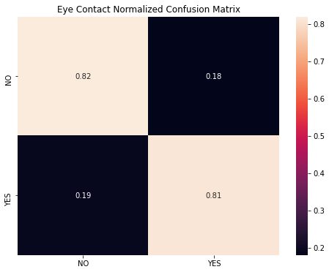
Results and Discussion
Eye Contact -Transfer Learning
The results that had been achieved was 82% in the training and testing datasets. The training process was smooth and took three hours to trigger auto stop function.
Confusion Matrix with Eye Contact

Slide 27

Results and Discussion
The Smile
The accuracy achieved in detecting the smile using the previously explained model ‎is 98%.
$$Precision= \frac{True Positives }{True Positives+FalsePositives }$$
The precision was 0.81 which is reasonable, especially the frames were manually evaluated and considering the transformation for the number of emotion classes .
Notes:
Since the actual labels are imbalanced, precision had been considered .

Slide 28
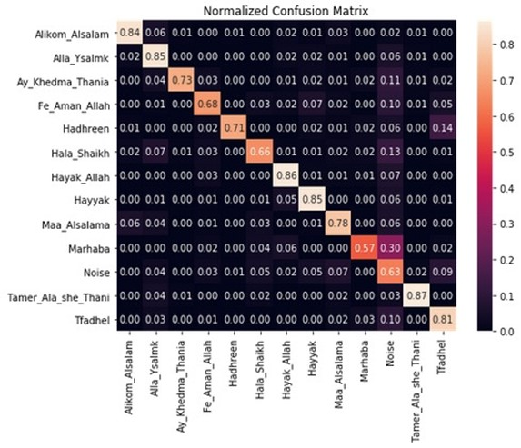
Results and Discussion
Audio
The accuracy result for the training dataset was 78% and for the testing was 76%.
Audio Confusion Matrix
Notes:
The Figure ‎is illustrating the accuracy and the validation accuracy of the model of the early stop in epoch 79.

Slide 29
Results and Discussion
Overall Results - Frames
Running the entire mechanism took about 20 minutes for 60 interviews to reach the overall results.
Sample from the overall result.
Since 1: Eye contact, 2: Sad,3: Angry,4: Surprise,5: Fear,6: Happy,7: Neutral,8: Disgust and 9: Captured frames
Interview Number | 1 | 2 | 3 | 4 | 5 | 6 | 7 | 8 | 9
P99999_05_07_2019_221229 | 0.82 | 0.36 | 0.00 | 0.55 | 0.00 | 0.09 | 0.00 | 0.00 | 0.15
Folds Cross Validation mean accuracy for the Multiple Logistic regression. Where K = 10 (Eye Contact).
K- Folds Cross Validation mean accuracy for the Multiple Logistic regression. Where K = 10 (Smile)
Notes:
Running the entire mechanism took about 20 minutes for 60 interviews to reach the overall results.
This is a sample of the overall results for one interview. The result shows that the ratio for the eye contact was 82% and 9% for the smile. However, only 15 % of the frames were captured.

Slide 30
Results and Discussion
Overall Results - Audio
After comparing the predicted result versus the quality assurance team evaluation, the accuracy achieved in the “Welcoming and Greeting” 78%, in the “Courtesy Word” 75%, in the “Closure” 73% and in the “Anything Else” 75%.
Audio Normalized Confusion Matrix

Slide 31
Results and Discussion
Overall Discussion
For the Frame part, the eye contact results were comparable with small variation among the five methods. While in the smile, decision tree has the highest standard deviation comparing to others that maintain almost the same standard deviation. The smile result was expected to be better than eye contact, as the smile is standard and easy to recognize by both the model and the human. However, the eye contact may vary a lot, depends on the staff who conducted the evaluation. Some may judge that the eye contact was enough for such transaction and other may object. Therefore, the result seems not bad for such kind of classification.
On the other hand, the audio has some wrong classified phrases that became correctly classified due to the aggregation process used in (Page 77). Moreover, the number of the subcategory was imbalanced comparing to their category in the post training process. For example, “Courtesy Words” owned only two subcategories while “Welcoming and Greeting” owned four subcategories which increased the probability of one over another.

Slide 32
Recommendations and future research
• Increasing the number of train dataset has noticeable positive impact on the accuracy. Thus, it is recommended to increase number of manual validated frames. The same applied also to the audio dataset before data augmentation.
• Validating data manually is a challenging task, setting a procedure to draw a path about how to conduct this validation making it a bit smother.
• Classifying quieter audio environment will be much easier. Therefore, applying the same mechanism on a call center while focusing on audio only is an opportunity for future research.
• Appling recurrent neural network e.g., Long Shot Term Memory (LSTM) for the audio, is another option for future work.
• Adding audio chunks from the original interview beside the augmented data is another option for the coming enhanced version.

Slide 33

Thank you ..

Slide 34
Backup slides

Slide 35
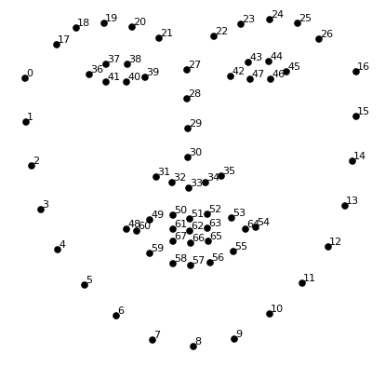
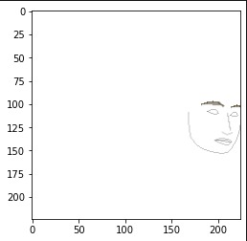
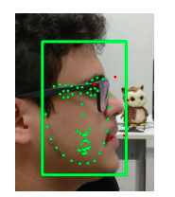
Stage 3 Eye Contact
Procedures and Methods- Frames
Attempt 1: Facial Landmarks
The 68 Face Landmarks (Geitgey, 2016)
Support Vector Machine
50%
Random Forests 61%
Female Front-line staff with eye contact
Facial Landmarks captured wrongly where the face is looking at one side.(Bezerra & Gomes, 2018)

Slide 36
Procedures and Methods - Audio
Audio Tracks Validation
It was expected that there must be some unrelated tracks, and thus had to be validated due to nature of collecting this kind of survey through social media. Thus, the tracks were manually validated by hearing all of them one by one.
Python and its libraries helped in listing all their duration and calculate their statistics.
Audio Tracks Before and After Validation
4734
3626

Slide 37
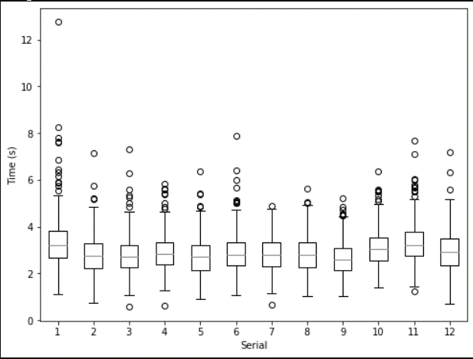
Procedures and Methods - Audio
Audio Tracks Validation
Outliers that fall below the lower quartile need to be reviewed twice, by asking someone else if the audio can be understood or not due to its speed while saying the phrase. And outliers that fall above the upper quartile were either said twice or there is a silence or noise between speech beginning or maybe ending. The below boxplots illustrates the outliers.
Serial | Mean | SD | Max | Min
1 | 3.1 | 0.7 | 4.5 | 1.1
2 | 2.2 | 0.6 | 3.1 | 0.8
3 | 2.3 | 0.6 | 3.5 | 1.0
4 | 2.2 | 0.6 | 3.2 | 0.6
5 | 1.7 | 0.7 | 2.9 | 0.9
6 | 2.5 | 0.5 | 3.5 | 1.1
7 | 2.4 | 0.5 | 3.3 | 0.8
8 | 2.5 | 0.6 | 3.8 | 1.1
9 | 2.1 | 0.7 | 3.1 | 1.0
10 | 3.0 | 0.6 | 4.2 | 1.4
11 | 3.2 | 0.7 | 4.8 | 1.2
12 | 2.9 | 0.8 | 5.1 | 0.7
Audio tracks Duration boxplots, after eliminating the Zero Duration
Descriptive Statistics for the duration per Second

